Slide 1



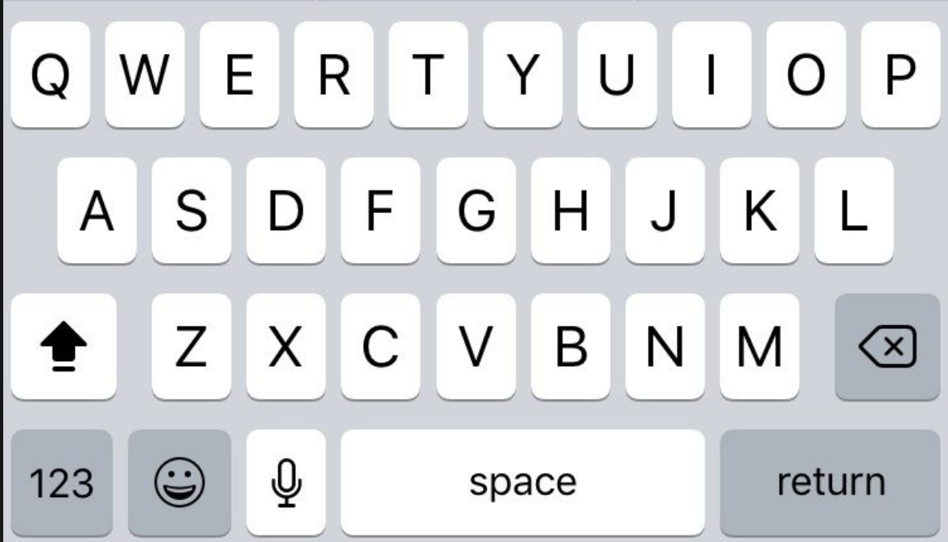





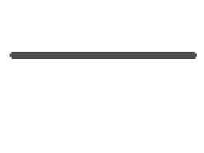



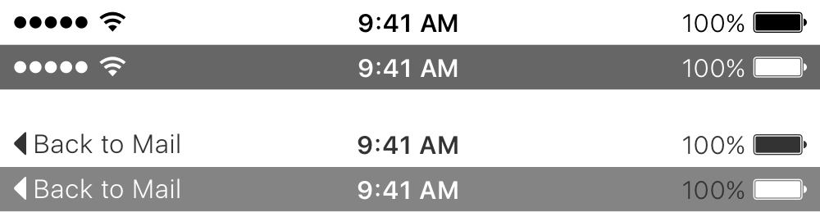
SETUP

Slide 2
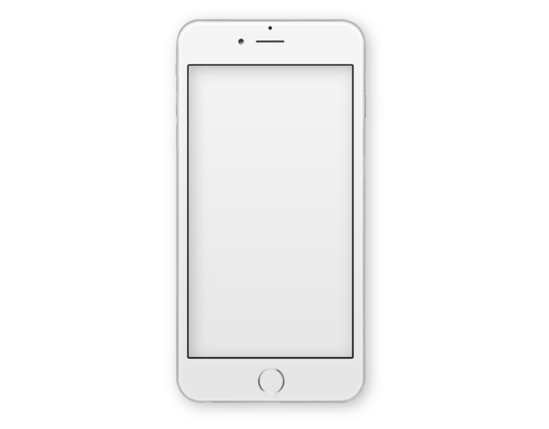

Simple. Safe. Smart.

Slide 3

Sign in:
Username:
Password:
Login
Sign Up

Slide 4
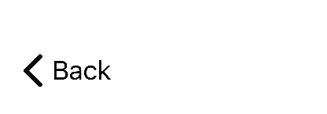
Sign up:
Username:
Phone:
Password:
Retype Password:
Sign Up

Slide 5


Welcome,
Matt
Let’s take a look at what you have going on...
4
2
Chat
Events Phone

Slide 6

Chat
Recent Conversations:
Malcom Jonas
Sam Snively
Tommy Wright
Joel Banks
Sam Brooks
New Conversation

Slide 7
New Conversation
Search for people...
Once you start searching, your results will appear here.

Slide 8
New Conversation
Jill
Results:
Jill Wagner

Slide 9
Jill Wagner
Once you send your message, it will appear here...
Type message...

Slide 10
Malcom Jonas
Today, 8:30AM
Hi, Malcom!
O, Hey. What’s on your mind?
Just wanted to see if you were going to the Chess
game today.
Wouldn’t miss it! Someone has to be champ!
Type message...

Slide 11



Events
Events from me
Events from friends
Create new Event

Slide 12
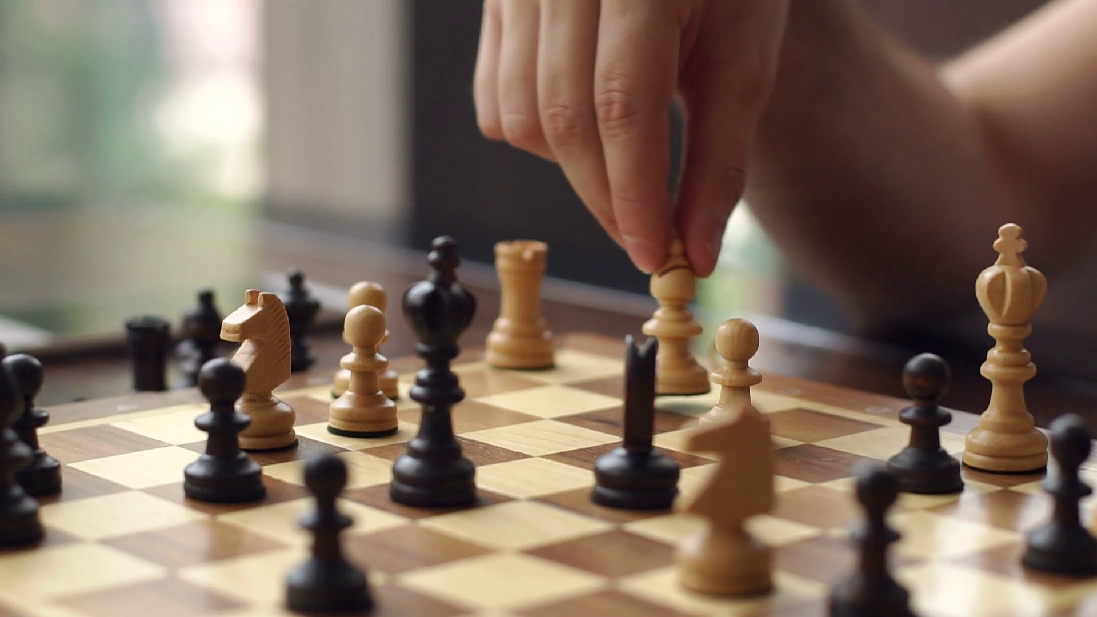

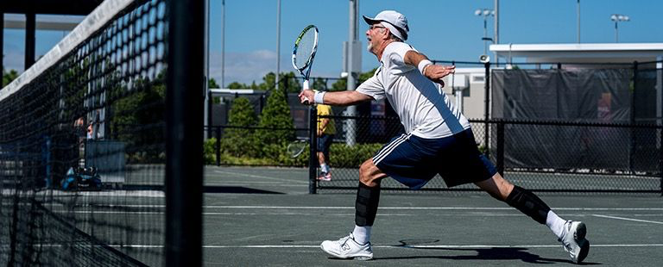
Events
Search...
Today, 12:30PM
Chess Match
Today, 6:30PM
Tennis Game
V Scroll Down for more V

Slide 13
More Info
Event: Chess Match
Date: 04/21/2019
Time: 12:30PM
Location: 123 Welch Ln. RM 102
Host: Jill Wagner
Sign Up Now

Slide 14
More Info
Event: Tennis Game
Date: 04/21/2019
Time: 6:30PM
Location: Halton Wagner Tennis Complex
Host: Tommy Wright
Sign Up Now

Slide 15

Success
You have signed up for this event!
OK

Slide 16
Create Event
Event Name:
Time:
Date:
Location:
Create Event

Slide 17
Success
You have created this event!
OK

Slide 18



Phone
704-650-3412
1 2
3
ABC DEF
4
5
6
GHI JKL MNO
7
8
9
PQRS TUV WXYZ
*
0
#
Place Call

Slide 19


Talk
Currently Talking with...
704-650-3412
Speaker
Dial Pad
End Call

Slide 20
Phone
Incoming Call from...
James Smith
Accept
Decline

Slide 21
My Events
Wow, it looks like you haven’t created any events yet!
To get started, just tap the button below.
Create new Event

Slide 22
My Events
? ? ? ? ? ? ?
? ? ? ? ? ? ?
My Event 1
Create new Event

